Slide 1

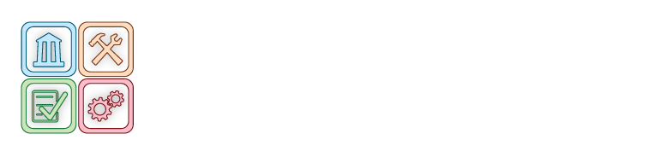

Software Assurance Maturity Model http://www.opensamm.org
Pravir Chandra
OpenSAMM Project Lead
chandra@owasp.org

Slide 2
Agenda
Review of existing secure SDLC efforts
Understanding the model
Applying the model
Exploring the model’s levels and activities
SAMM and the real world

Slide 3
By the end, you’ll be able to...
Evaluate an organization’s existing software security practices
Build a balanced software security assurance program in well-defined iterations
Demonstrate concrete improvements to a security assurance program
Define and measure security-related activities throughout an organization

Slide 4

Review of existing secure SDLC efforts

Slide 5
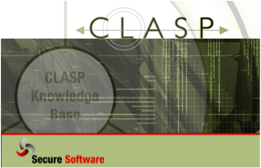
CLASP
Comprehensive, Lightweight Application Security Process
  Centered around 7 AppSec Best Practices
  Cover the entire software lifecycle (not just development)
Adaptable to any development process
  Defines roles across the SDLC
  24 role-based process components
  Start small and dial-in to your needs

Slide 6
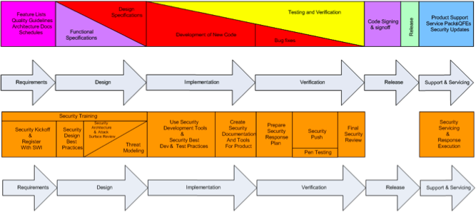
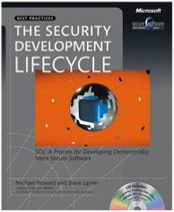
Microsoft SDL
Built internally for MS software
Extended and made public for others
MS-only versions since public release

Slide 7
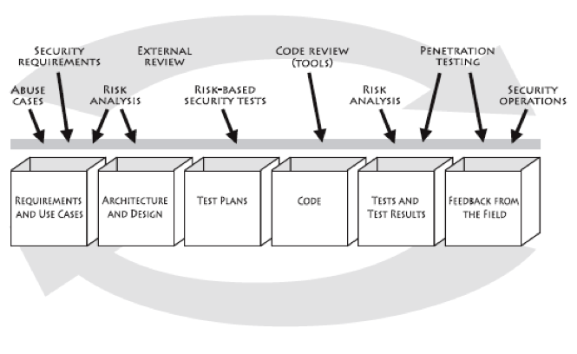
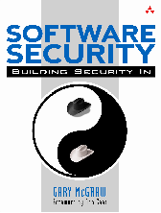
Touchpoints
Gary McGraw’s and Cigital’s model

Slide 8
Lessons Learned
Microsoft SDL
  Heavyweight, good for large ISVs
Touchpoints
  High-level, not enough details to execute against
CLASP
  Large collection of activities, but no priority ordering
ALL: Good for experts to use as a guide, but hard for non-security folks to use off the shelf

Slide 9
Drivers for a Maturity Model
An organization’s behavior changes slowly over time
  Changes must be iterative while working toward long-term goals
There is no single recipe that works for all organizations
  A solution must enable risk-based choices tailor to the organization
Guidance related to security activities must be prescriptive
  A solution must provide enough details for non-security-people
Overall, must be simple, well-defined, and measurable

Slide 10
Therefore, a viable model must...
Define building blocks for an assurance program
  Delineate all functions within an organization that could be improved over time
Define how building blocks should be combined
  Make creating change in iterations a no-brainer
Define details for each building block clearly
  Clarify the security-relevant parts in a widely applicable way (for any org doing software dev)

Slide 11

Understanding the model

Slide 12




SAMM Business Functions
Start with the core activities tied to any organization performing software development
Named generically, but should resonate with any developer or manager

Slide 13
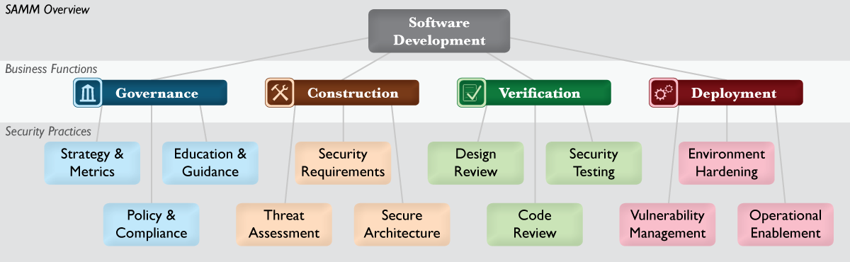
SAMM Security Practices
From each of the Business Functions, 3 Security Practices are defined
The Security Practices cover all areas relevant to software security assurance
Each one is a ‘silo’ for improvement

Slide 14
Under each Security Practice
Three successive Objectives under each Practice define how it can be improved over time
  This establishes a notion of a Level at which an organization fulfills a given Practice
The three Levels for a Practice generally correspond to:
  (0: Implicit starting point with the Practice unfulfilled)
  1: Initial understanding and ad hoc provision of the Practice
  2: Increase efficiency and/or effectiveness of the Practice
  3: Comprehensive mastery of the Practice at scale

Slide 15
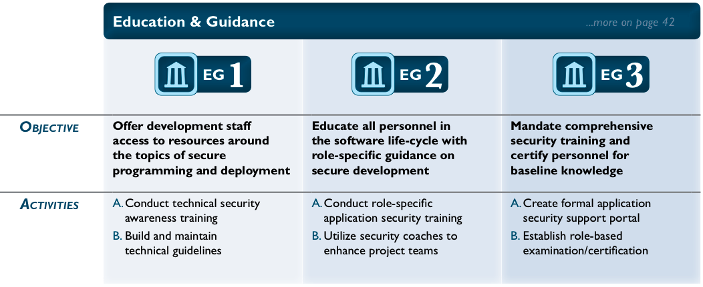
Check out this one...

Slide 16
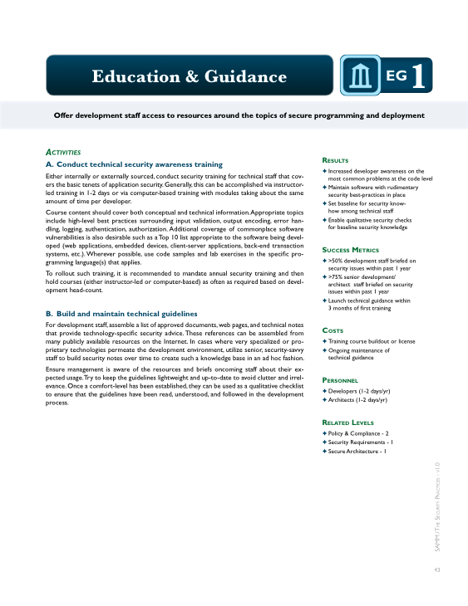
Per Level, SAMM defines...
Objective
Activities
Results
Success Metrics
Costs
Personnel
Related Levels

Slide 17
Approach to iterative improvement
Since the twelve Practices are each a maturity area, the successive Objectives represent the “building blocks” for any assurance program
Simply put, improve an assurance program in phases by:
  Select security Practices to improve in next phase of assurance program
  Achieve the next Objective in each Practice by performing the corresponding Activities at the specified Success Metrics

Slide 18

Applying the model

Slide 19
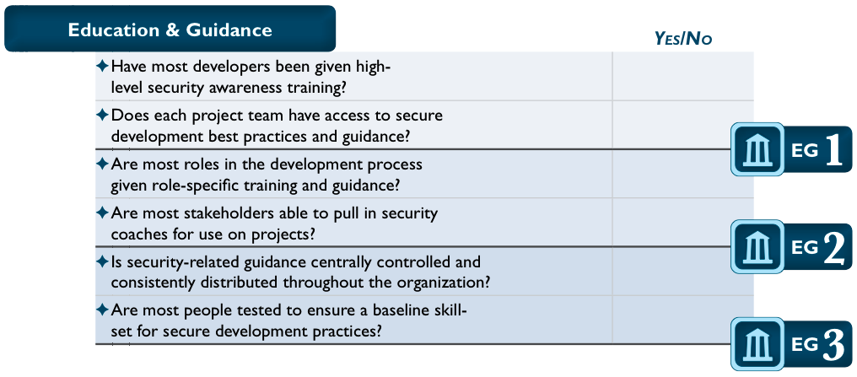
Conducting assessments
SAMM includes assessment worksheets for each Security Practice

Slide 20
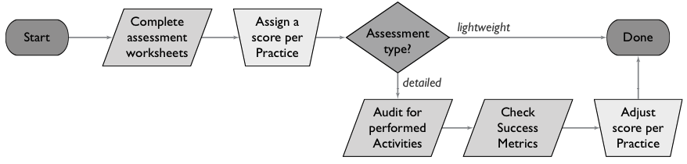
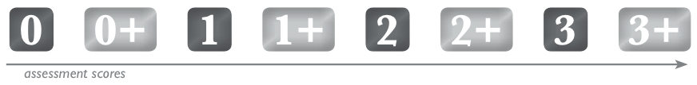
Assessment process
Supports both lightweight and detailed assessments
Organizations may fall in between levels (+)

Slide 21
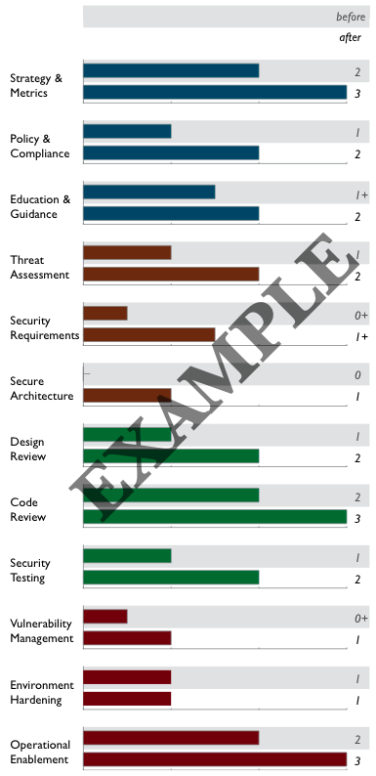
Creating Scorecards
Gap analysis
  Capturing scores from detailed assessments versus expected performance levels
Demonstrating improvement
  Capturing scores from before and after an iteration of assurance program build-out
Ongoing measurement
  Capturing scores over consistent time frames for an assurance program that is already in place

Slide 22
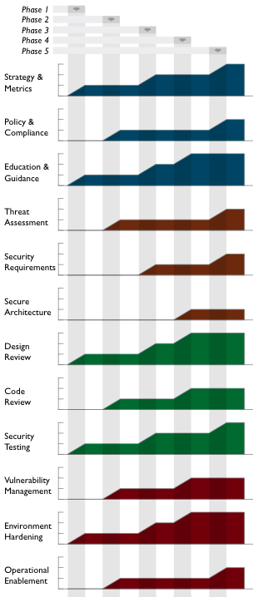
Roadmap templates
To make the “building blocks” usable, SAMM defines Roadmaps templates for typical kinds of organizations
  Independent Software Vendors
  Online Service Providers
  Financial Services Organizations
  Government Organizations
Organization types chosen because
  They represent common use-cases
  Each organization has variations in typical software-induced risk
  Optimal creation of an assurance program is different for each

Slide 23
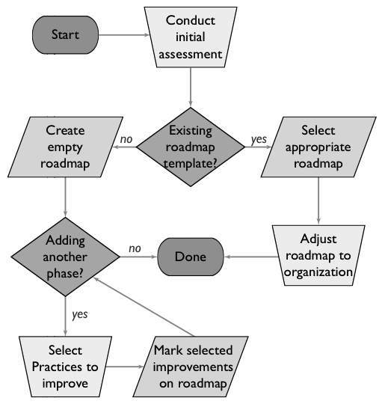
Building Assurance Programs

Slide 24
Case Studies
A full walkthrough with prose explanations of decision-making as an organization improves
Each Phase described in detail
  Organizational constraints
  Build/buy choices
One case study exists today, several more in progress using industry partners

Slide 25

Exploring the model’s levels and activities

Slide 26
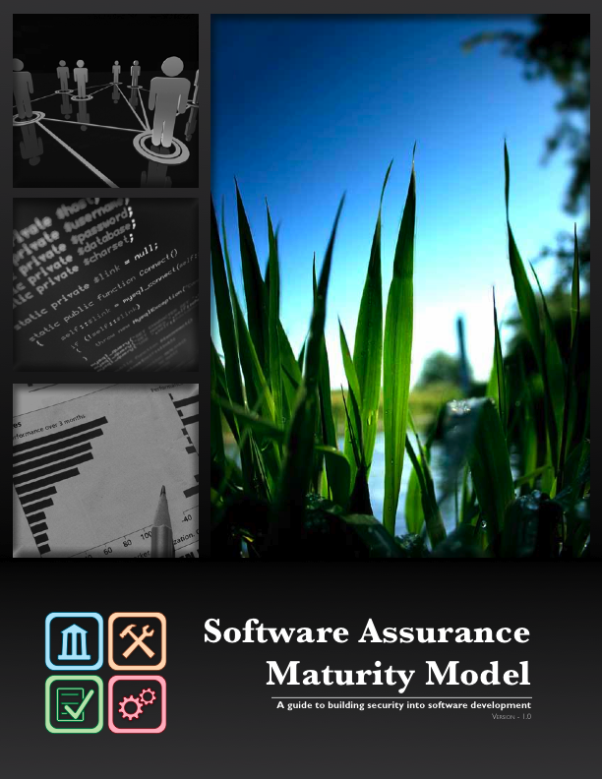
The SAMM 1.0 release

Slide 27

SAMM and the real world

Slide 28
SAMM history
Beta released August 2008
  1.0 released March 2009
Originally funded by Fortify
  Still actively involved and using this model
Released under a Creative Commons Attribution Share-Alike license
Donated to OWASP and is currently an OWASP project

Slide 29
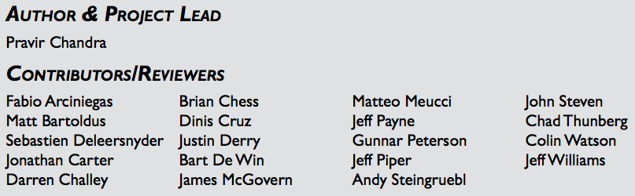
Expert contributions
Built based on collected experiences with 100’s of organizations
  Including security experts, developers, architects, development managers, IT managers

Slide 30
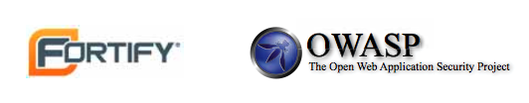
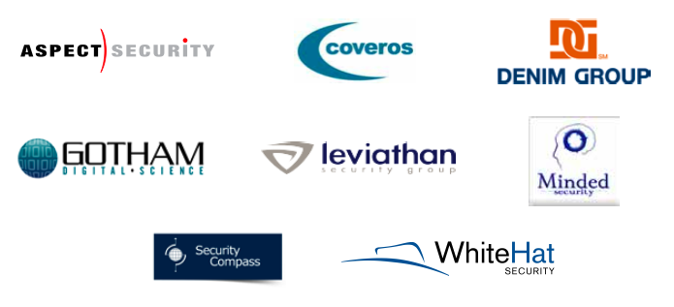
Industry support
Several more case studies underway

Slide 31
The OpenSAMM Project
http://www.opensamm.org
Dedicated to defining, improving, and testing the SAMM framework
Always vendor-neutral, but lots of industry participation
  Open and community driven
Targeting new releases every 6-12 months
Change management process
  SAMM Enhancement Proposals (SEP)

Slide 32
Future plans
Mappings to existing standards and regulations (many underway currently)
  PCI, COBIT, ISO-17799/27002, ISM3, etc.
Additional roadmaps where need is identified
Additional case studies
Feedback for refinement of the model
Translations into other languages

Slide 33
Other “modern” approachs
Microsoft SDL Optimization Model
Fortify/Cigital Building Security In Maturity Model (BSIMM)

Slide 34
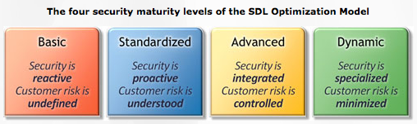
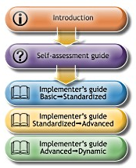
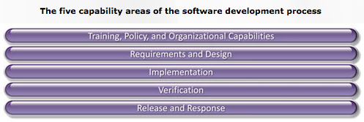
SDL Optimization Model
Built by MS to make SDL adoption easier

Slide 35
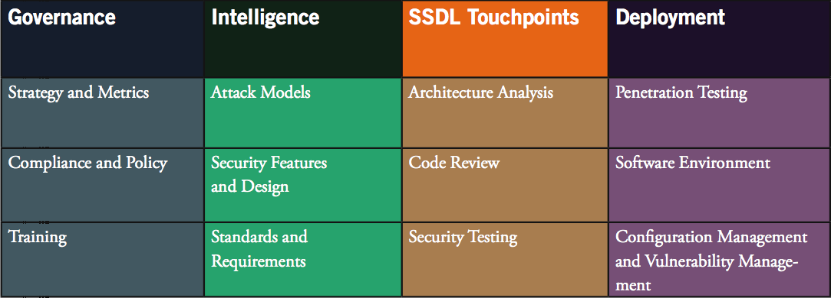
BSIMM
Framework derived from SAMM Beta
Based on collected data from 9 large firms

Slide 36
Quick re-cap on using SAMM
Evaluate an organization’s existing software security practices
Build a balanced software security assurance program in well-defined iterations
Demonstrate concrete improvements to a security assurance program
Define and measure security-related activities throughout an organization

Slide 37
Get involved
Use SAMM and tell us about it
  Blog, email, etc.
Latest news at http://www.opensamm.org
  Sign up for the mailing list

Slide 38
Thanks for your time! Questions? http://www.opensamm.org
Pravir Chandra
OpenSAMM Project Lead
chandra@owasp.org

